Slide 1
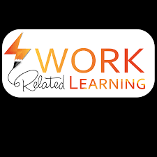

Work Related learning
Week 7-
LO3- Examine the structure, culture and function of an organisation

Slide 2
Learning outcomes
Be
At the end of this session, students will be able to ;
Describe
1-Describe the Basic structure of An organisation.
Explain
2-Explain the functions Of An Organisation.

Slide 3

LO1 Activity -10 mins
Class Discussion
What is An Organisation ?

Slide 4
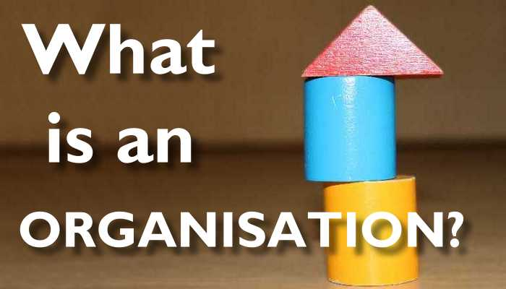

Slide 5
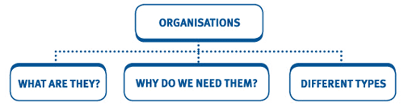

Slide 6
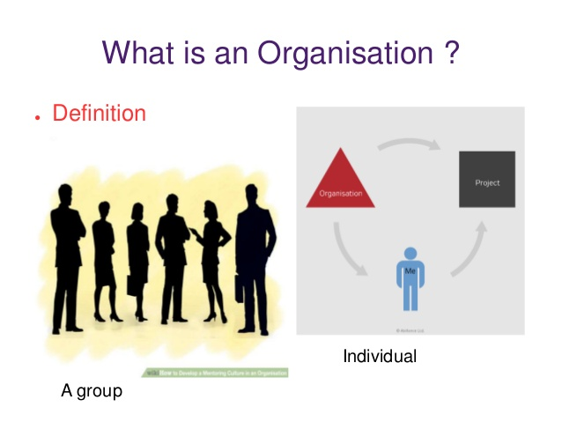
Organisation
Ever since the dawn of civilization, people have always formed organisations to combine their efforts for the accomplishments of their common goals.
For example, the Emperors of China used organisations a thousand years ago to construct great irrigation systems.
The first Pope created a universal church to serve a world religion.
The greatest example is the construction of great pyramids by the early Egyptians.

Slide 7
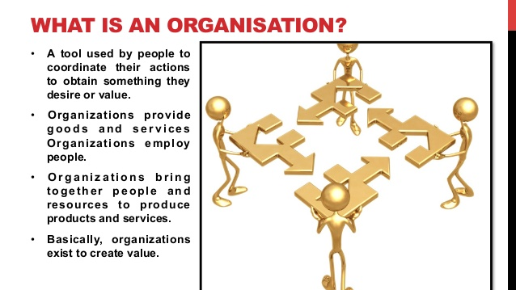

Slide 8

Concept of Organisation:
It is very difficult to define the term organisation precisely because the use of the term organisation is not standardized. It is not static.
It is dynamic and ever changing as per the needs of society, its members, business objectives and environmental changes.
Organisation has been defined in different ways by different theorists, because different theorists have emphasized different characteristics of organisation.

Slide 9

An organization, or organisation, is an entity – such as a company, an institution, or an association – comprising one or more people and having a particular purpose.
“Organisations are defined as collect ivities that have been established for the pursuit of relatively specific objectives on a more or less continuous basis.
Organisations have more or less fixed boundaries, a normative order, authority rank, a communication system and an incentive system which enables various types of participants to work together in the pursuit of common goals.”

Slide 10

An organization is a group of people who work together, like a neighborhood association, a charity, a union, or a corporation. Organization is also the act of forming or establishing something (like an organization). It can also refer to a system of arrangement or order, or a structure for classifying things.

Slide 11
What is an Organisation in health and social care?
The Health and Social Care sector consists of any organisation which provides healthcare support to people, for example hospitals, dentists, and specialist support like physiotherapy, and social care support, for example, nursing homes, foster caring, and nurseries.
The Health and Social Care sector consists of any organisation which provides healthcare support to people, for example hospitals, dentists, and specialist support like physiotherapy, and social care support, for example, nursing homes, foster caring, and nurseries. In short, it includes any organisation or service which helps people live more independent, healthier lives.

Slide 12
LO1-Activity-Individual Research -10mins
Conduct an individual research ;
What is organisational structure ?

Slide 13
An organizational structure is a system that outlines how certain activities are directed in order to achieve the goals of an organization. These activities can include rules, roles, and responsibilities.
The organizational structure also determines how information flows between levels within the company.
For example, in a centralized structure, decisions flow from the top down, while in a decentralized structure, decision-making power is distributed among various levels of the organization.
Having an organizational structure in place allows companies to remain efficient and focused.
What Is an Organizational Structure?

Slide 14
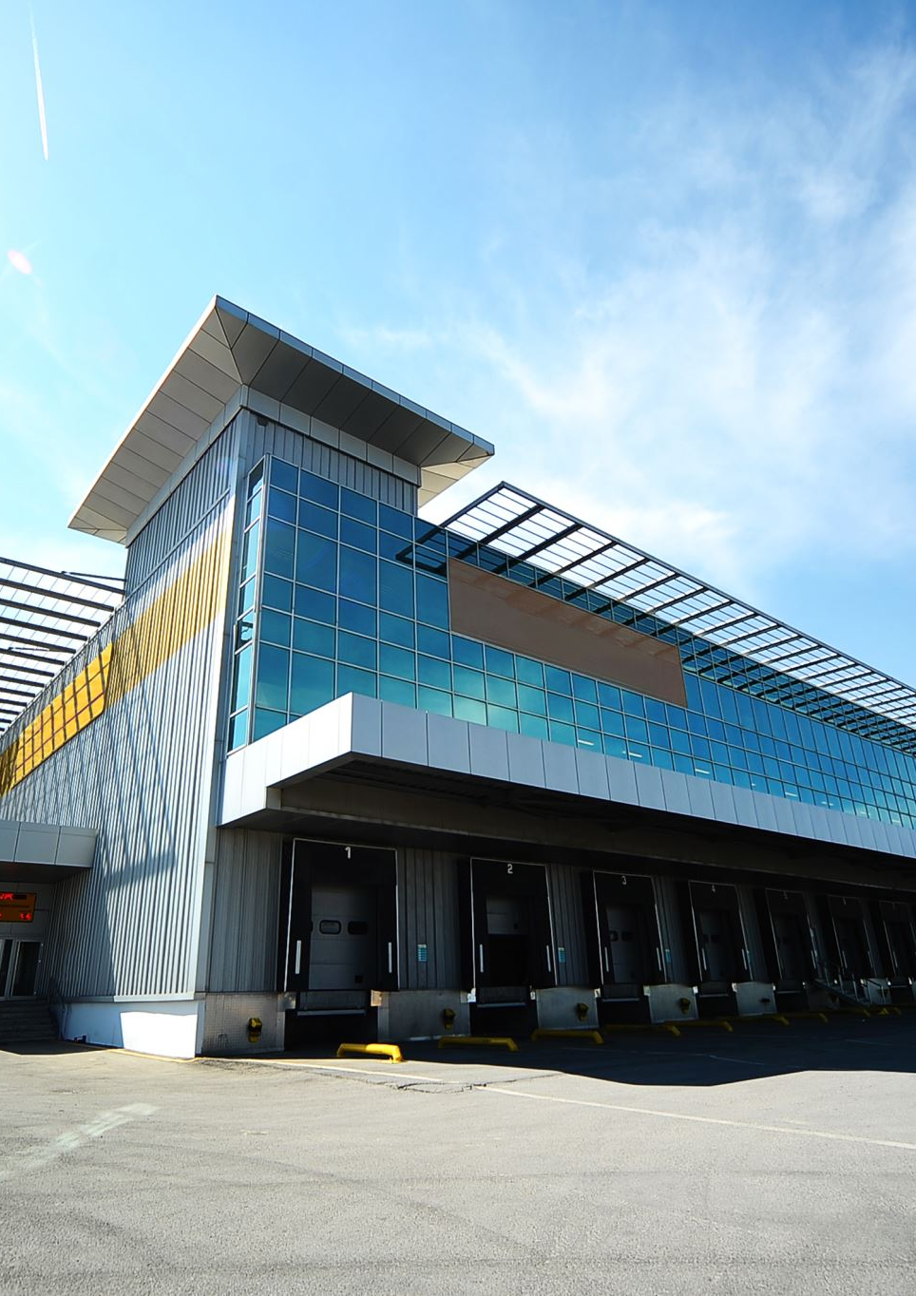
Businesses of all shapes and sizes use organizational structures heavily. They define a specific hierarchy within an organization.
A successful organizational structure defines each employee's job and how it fits within the overall system.
Put simply, the organizational structure lays out who does what so the company can meet its objectives.
This structuring provides a company with a visual representation of how it is shaped and how it can best move forward in achieving its goals.
Organizational structures are normally illustrated in some sort of chart or diagram like a pyramid, where the most powerful members of the organization sit at the top, while those with the least amount of power are at the bottom.

Slide 15

Models of organizational structure
Hierarchical org structure
Functional org structure
Horizontal or flat org structure
Divisional org structures (market-based, product-based, geographic)
Matrix org structure
Team-based org structure
Network org structure.

Slide 16

Cont…
Not having a formal structure in place may prove difficult for certain organizations. For instance, employees may have difficulty knowing to whom they should report.
That can lead to uncertainty as to who is responsible for what in the organization.
Having a structure in place can help with efficiency and provide clarity for everyone at every level.
That also means each and every department can be more productive, as they are likely to be more focused on energy and time.

Slide 17
Benefits of Organizational Structures
Putting an organizational structure in place can be very beneficial to a company.
The structure not only defines a company's hierarchy but also allows the firm to layout the pay structure for its employees.
By putting the organizational structure in place, the firm can decide salary grades and ranges for each position.
The structure also makes operations more efficient and much more effective.
By separating employees and functions into different departments, the company can perform different operations at once seamlessly.

Slide 18
In addition, a very clear organizational structure informs employees how best to get their jobs done.
For example, in a hierarchical organization, employees will have to work harder at buying favor or courting those with decision-making power.
This can also help set expectations for how employees can track their own growth within a company and emphasize a certain set of skills—as well as for potential employees to gauge if such a company would be a good fit with their own interests and work styles.
Benefits

Slide 19
Benefits
Underlying the effective management of people is the requirement for a clear understanding of the nature of the business in which the organisation is engaged.
If the organisation is to be successful then its structure must be related to its objectives and to its strategy.
Structure must be designed to be appropriate to environmental influences, the continued development of the business and the management of opportunities and risks.
Good organisation structure does not by itself produce good performance.
But a poor organisation structure makes good performance impossible, no matter how good the individual managers may be.
To improve organisation structure . . . will therefore always improve performance.

Slide 20

Benefits
An organizational structure outlines how certain activities are directed to achieve the goals of an organization.
Successful organizational structures define each employee's job and how it fits within the overall system.
A centralized structure has a defined chain of command, while decentralized structures give almost every employee receiving a high level of personal agency.
Types of organizational structures include functional, divisional, flatarchy, and matrix structures.
Senior leaders should consider a variety of factors before deciding which type of organization is best for their business, including the business goals, industry, and culture of the company

Slide 21
Benefits
Economic and efficient performance of the organisation and level of resource utilisation;
Monitoring activities of the organisation;
Accountability for areas of work undertaken by groups and individual members of the organisation;
Co-ordination of different parts of the organisation and different areas of work;
Flexibility in order to respond to future demands and developments, and to adapt to changing environmental influences; and
Social satisfaction of members working in the organisation.

Slide 22
Matrix Structure
Matrix Structure Combines Functional and Divisional Models;
It is also the most confusing and the least used.
This structure matrixes employees across different superiors, divisions, or departments.
An employee working for a matrixed company, for example, may have duties in both sales and customer service.
A matrix structure combines elements of the functional and divisional models, so it’s more complex.
It groups people into functional departments of specialization, then further separates them into divisional projects and products.

Slide 23
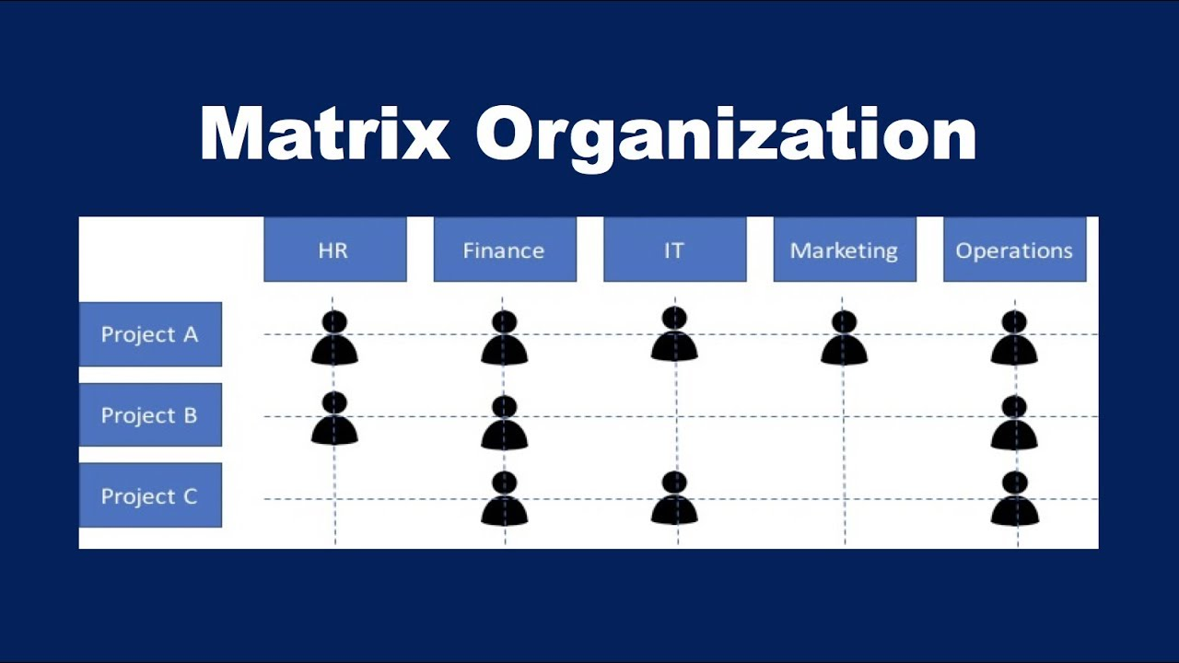
Matrix Structure-CONT…
In a matrix structure the team members are given more autonomy and expected to take on more responsibility for their work.
This increases the productivity of the team, fosters greater innovation and creativity, and allows managers to cooperatively solve decision-making problems through group interaction.
This type of organizational structure takes lots of planning and effort, making it appropriate for large companies that have the resources to devote to managing a complex business framework.

Slide 24
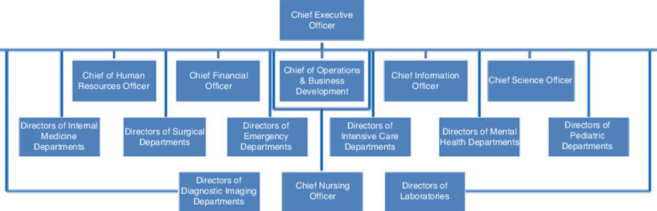
Typical organizational chart for a hospital

Slide 25
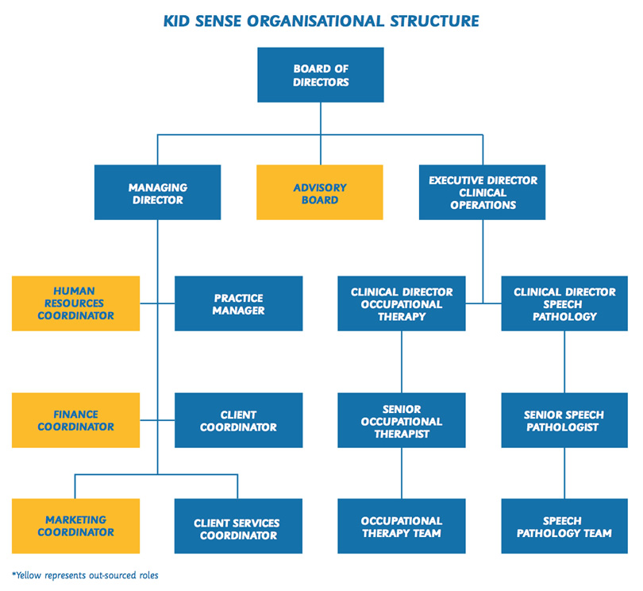

Slide 26
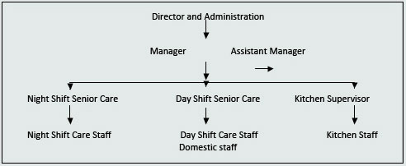

Slide 27
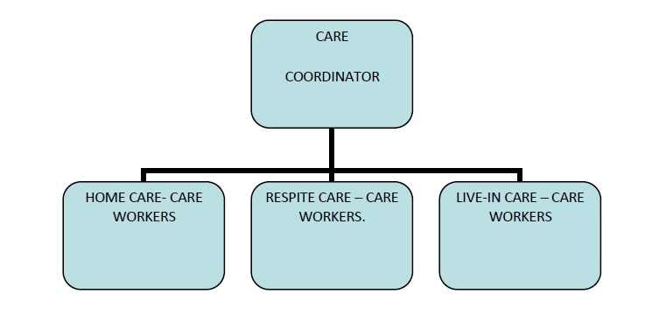

Slide 28
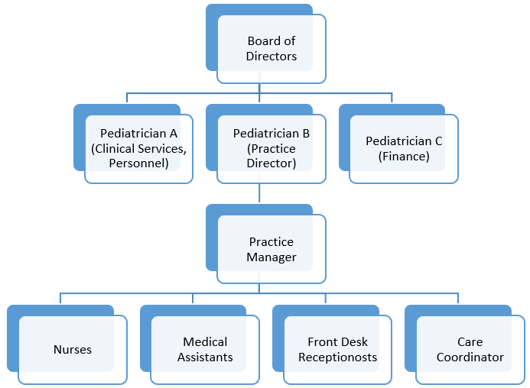
Nursing home organigram

Slide 29
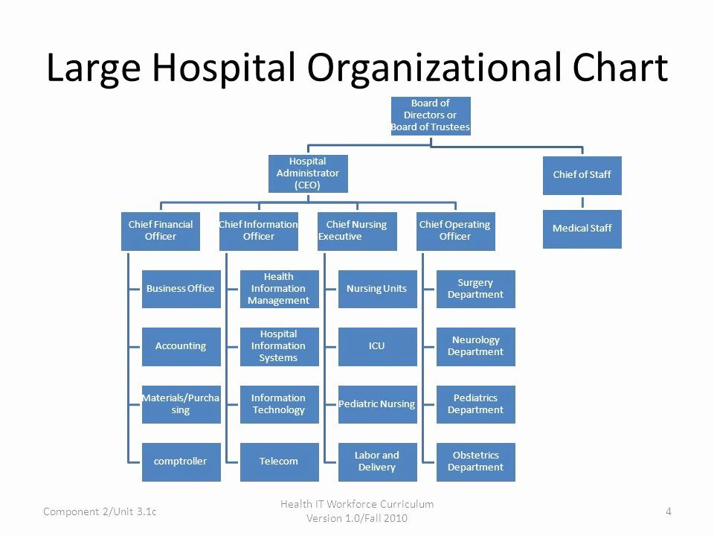

Slide 30
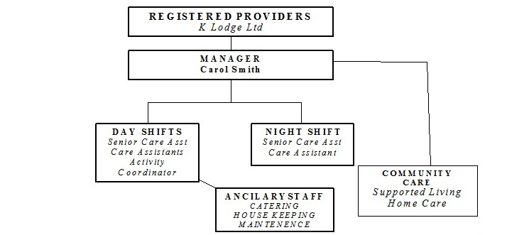

Slide 31
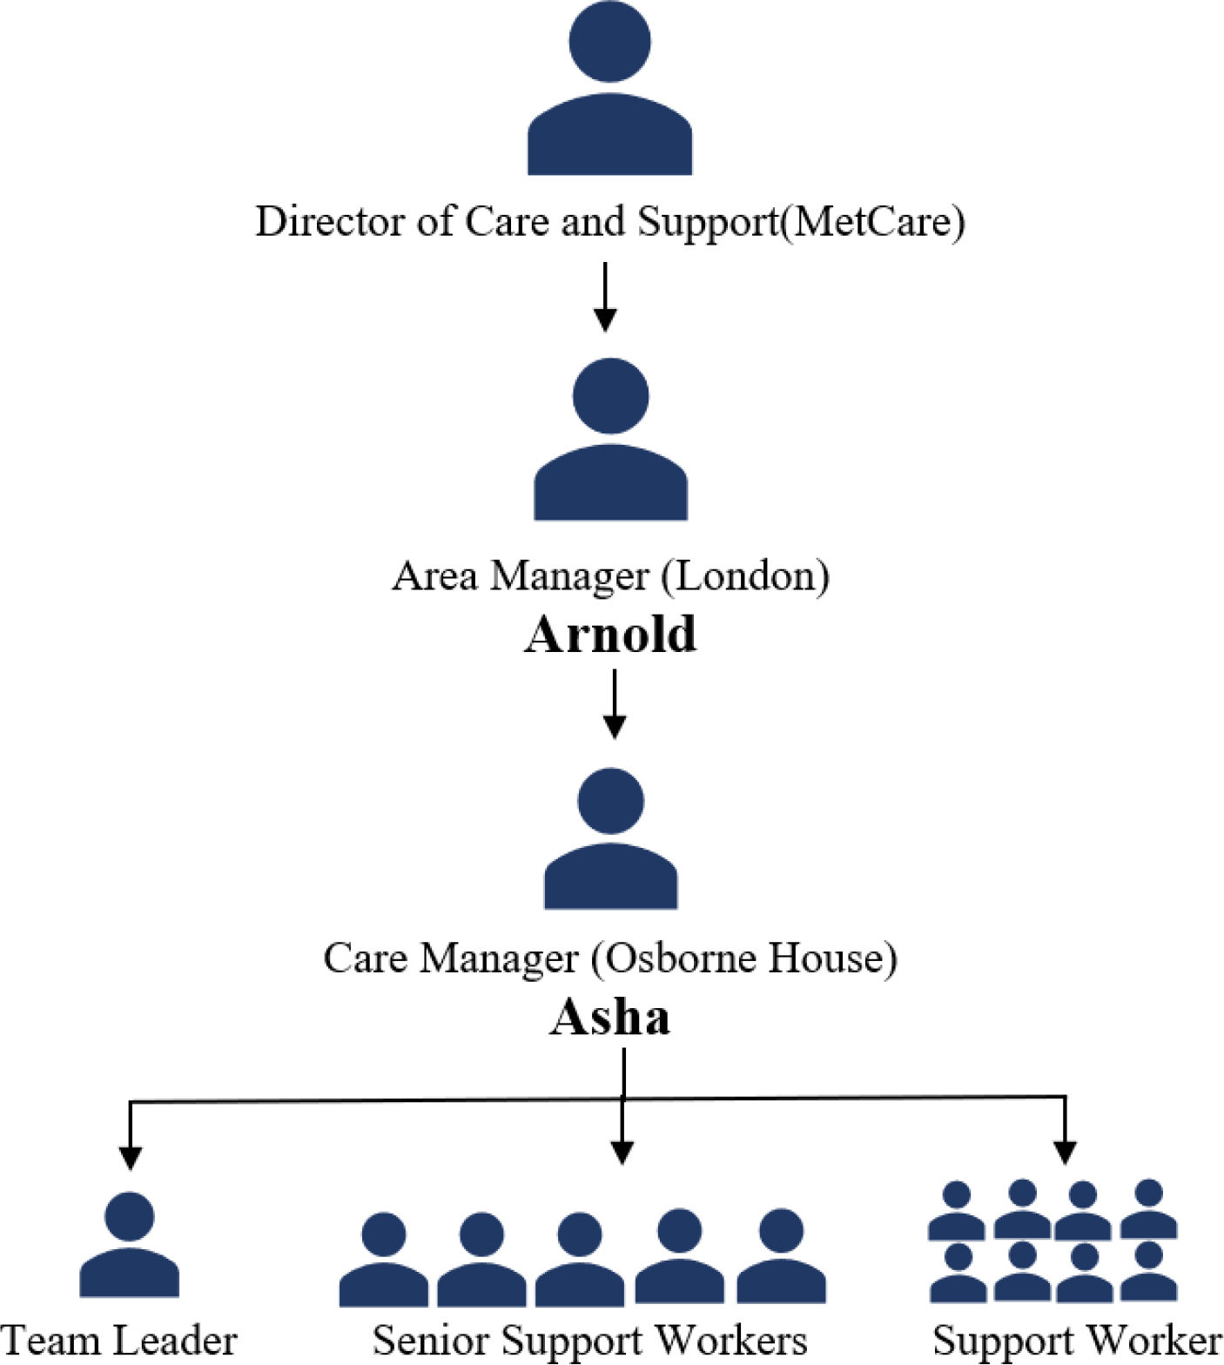

Slide 32

Functional Structure:
Under a functional organization structure, people who do similar tasks are grouped together based on specialty.
So, all the accountants are placed in the finance department and so on for the marketing, operations, senior management and human resources departments.
A functional org structure starts with positions with the highest levels of responsibility at the top and goes down from there.
Primarily, though, employees are organized according to their specific skills and their corresponding function in the company. Each separate department is managed independently.

Slide 33
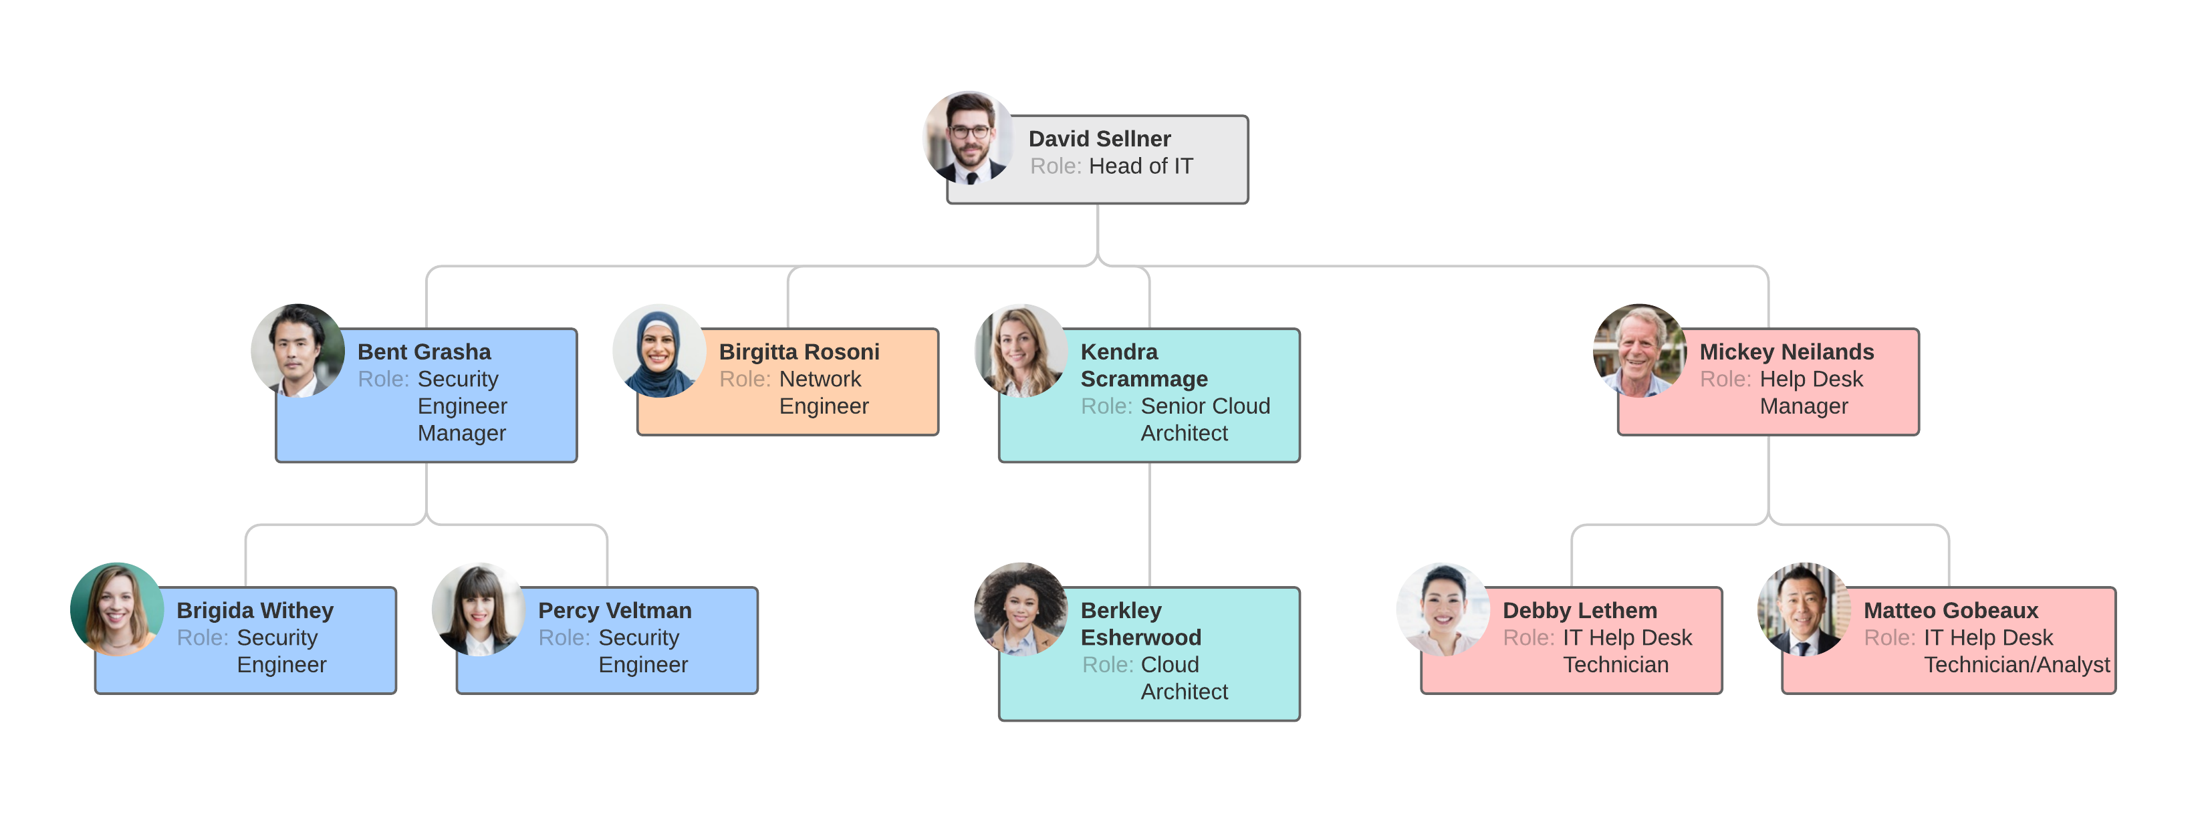
Functional org structure
The advantages of this kind of structure include quick decision making, because the group members can easily communicate. They can also learn from each other, since they already possess similar skill sets and interests.

Slide 34

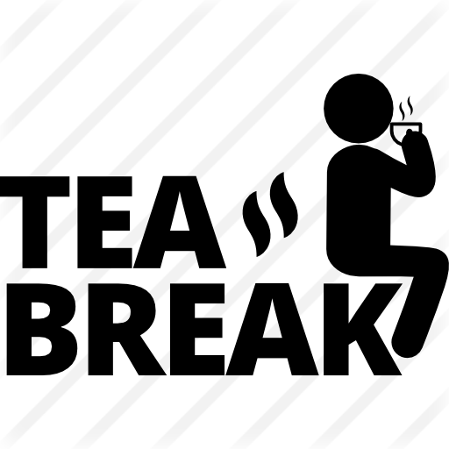
10 minutes break

Slide 35
Flatarchy, a newer structure, is the third type and is used among many startups.
As the name alludes, it flattens the hierarchy and chain of command and gives its employees a lot of autonomy.
A flat organizational structure attempts to disrupt the traditional top-down management system of most companies.
Management is decentralized so there is no everyday “boss.” Each employee is the boss of themselves, eliminating bureaucracy and red tape and improving direct communication.
some organizations maintain this structure since it encourages less supervision and more involvement from all employees.
Flat Organizational Structure

Slide 36
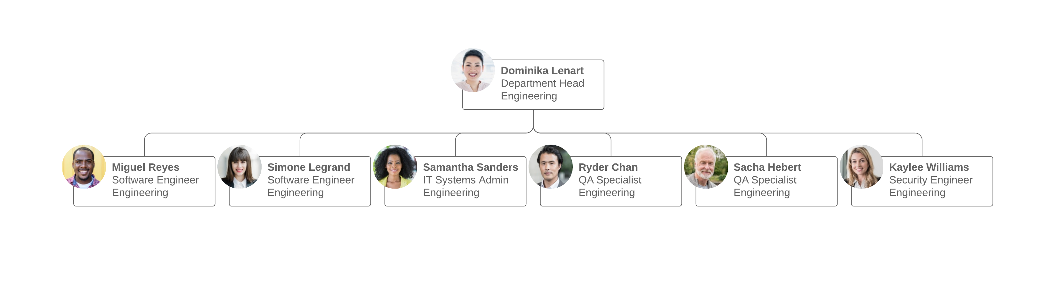
Horizontal or flat org structure
For example, an employee who has an idea doesn’t have to wade through three levels of upper managers to get the idea to the key person making the decision. The employee simply communicates directly with the target on a peer-based level.
A company adopting this type of structure for everyday purposes typically establishes a special top-down management system for temporary projects or events.

Slide 37
Hierarchical org structure.
The pyramid-shaped organizational chart we referred to earlier is known as a hierarchical org chart. It’s the most common type of organizational structure––the chain of command goes from the top (e.g., the CEO or manager) down (e.g., entry-level and low-level employees) and each employee has a supervisor.

Slide 38
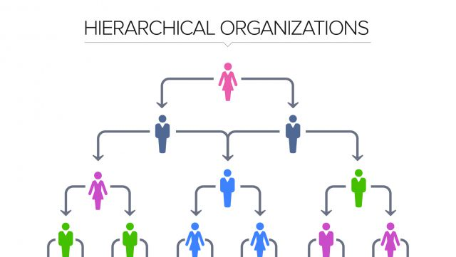
Hierarchical org structure.

Slide 39
Divisional org structure
In divisional organizational structures, a company’s divisions have control over their own resources, essentially operating like their own company within the larger organization.
Each division can have its own marketing team, sales team, IT team, etc.
This structure works well for large companies as it empowers the various divisions to make decisions without everyone having to report to just a few executives.

Slide 40
Depending on your organization’s focus, there’s a few variations to consider:
Market-based divisional org structure
Divisions are separated by market, industry, or customer type. A large consumer goods company, like Target or Walmart, might separate its durable goods (clothing, electronics, furniture, etc.) from its food or logistics divisions.
Product-based divisional org structure
Divisions are separated by product line. For example, a tech company might have a division dedicated to its cloud offerings, while the rest of the divisions focus on the different software offerings––e.g., Adobe and its creative suite of Illustrator, Photoshop, etc.
Geographic divisional org structure
Divisions are separated by region, territories, or districts, offering more effective localization and logistics. Companies might establish satellite offices across the country country or the globe in order to stay close to their customers.

Slide 41

Team-based org structure
It’ll come as no surprise that a team-based organizational structure groups employees according to (what else?) teams––think scrum teams or tiger teams.
A team organizational structure is meant to disrupt the traditional hierarchy, focusing more on problem solving, cooperation, and giving employees more control.

Slide 42
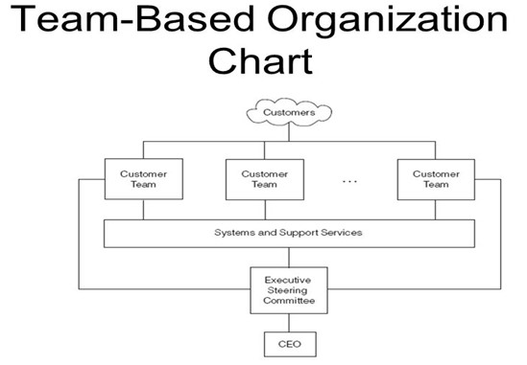

Slide 43
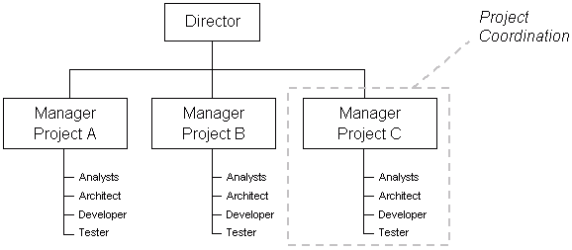
Project based organisation structure

Slide 44
Network org structure
These days, few businesses have all their services under one roof, and juggling the multitudes of vendors, subcontractors, freelancers, offsite locations, and satellite offices can get confusing.
A network organizational structure makes sense of the spread of resources.
It can also describe an internal structure that focuses more on open communication and relationships rather than hierarchy.

Slide 45
LO2 Activity – Individual Research –(10mins)
What are the functions of a health and social care organisation

Slide 46

The NHS: It's not just a job, it's a career
https://youtu.be/xBDF0_-EiGI
We’re helping 10,000 young people get into the Health and Social Care sector.
It’s not just doctors and nurses. We’re helping find jobs for future Digital Managers, Finance Administrators, and Lab Technicians, just like Ellie.
If you want a career in health or social care and need some help getting your foot in the door, sign up for one of our courses

Slide 47

Working together and major function
Within the formal structure, work has to be divided among its members and different jobs related to each other.
The division of work and the grouping together of people should, wherever possible, be organised by reference to some common characteristic that forms a logical link between the activities involved.
Work can be divided, and activities linked together, in a variety of ways.
The most common basis for grouping activities is according to specialisation, the use of the same set of resources, or the shared expertise of members of staff.
It is a matter for decision in each organisation as to which activities are important enough to be organised into separate functions, departments or sections.

Slide 48
What is it like to work for the Health and Social Care organisation?
The answer depends on what job you do and where you work.
The Health and Social Care sector contains pretty much any role you can think of, and loads of fun ones that you’ve probably never thought of, like being a Children’s Play Care Assistant!
The sector also values flexibility.
When you're in, you can move around between different sectors so you're not locked in to a particular job type.
That makes it ideal for anyone who isn't quite sure what they want to do. Of course, if you're aiming for a particular job or career path, you can also achieve that.

Slide 49
What career paths are available from each role?​
All roles in the Health and Care sector are designed so that people can either stay in their role or be promoted through different career paths. For example, a Healthcare Assistant can train to be a qualified nurse within 5 years, and for many careers, the employer can opt to sponsor further education if this is a path you want to follow.
Did you know?
There are over 350 jobs roles in the Health and Social Care sector?
The NHS is Europe's biggest employer and the fifth biggest employer in the world. Nearly 1.5 million patients interact with the NHS every 24 hours
There are over 100,000 vacancies at any time in the sector ​

Slide 50

Promote and support the involvement of people in the monitoring, commissioning and provision of local health and social care services.
Provide information and advice to the public about accessing health and social care services and the options available to them.

Slide 51
Working in health and social care organisation
Clinical roles
These provide a front-line service or working in a laboratory; a doctor or a nurse would be a clinical role. There are lots of other clinical roles in the sector and many of them do not require any qualifications (such as GCSEs or A-Levels). ​
Non-clinical roles
In these, workers do not interact with patients but provide the support and guidance that are needed to run a unit. Any role that you can think would be needed to run an organisation, such as IT Managers, Digital Marketers, and Customer Support. ​

Slide 52
Functions
Locally, clinical commissioning groups – made up of doctors, nurses and other professionals – will buy services for patients, while local councils formally take on their new roles in promoting public health.
Health and wellbeing boards will bring together local organisations to work in partnership and Healthwatch will provide a powerful voice for patients and local communities.

Slide 53
Reflection
Determine your career pathway into the selected organisation?
Which function in an organisation you are interested with?
Have a reflection on your skills and abilities to achieve this goal
How you would meet the person specification of the selected career pathway into the selected organisation.

Slide 54
Assessment methods
The assessment Guide for Work Related Learning (WRL) has one (1) summative component:
Individual Report (weighted 100%)
Tasks to be completed (of not more than 2500 words)
Collate an individual report which assesses the health and social care sector, taking into account the current situation of the CoVid19 pandemic.
Explore how this has impacted the career prospects for health and social care.
Evaluate an organisation as an exemplar to justify your stand, by applying the theories and models learned from this module.

Slide 55
Reference list.
Lee, S.M., Luthans, F. and Olson, D.L., 1982. A management science approach to contingency models of organizational structure. Academy of Management Journal, 25(3), pp.553-566.
Child, J., 1972. Organizational structure, environment and performance: The role of strategic choice. sociology, 6(1), pp.1-22.
Hannan, M.T., Freeman, J.H. and Meyer, J.W., 1976. Specification of models for organizational effectiveness. American Sociological Review, 41(1), pp.136-143.
https://www.yourarticlelibrary.com/organization/organisation-meaning-concept-features-and-advantages/63768
https://www.nhsconfed.org/resources/key-statistics-on-the-nhs

